Slide 1
Master Your B5 [A Must for Business Success]
Frank Chang

Slide 2
Attitude and Knowledge
Goals and a Goal Statement
Retailing
Basic 5
Prospecting, Recruiting and Sponsoring
Follow Up and the ABC Pattern of Building Depth
Fundamentals of the Business

Slide 3
B5 is Universal. It is the
ways to do things RIGHT

Slide 4
THE BASIC 5 IS ANALOGOUS TO A 4 LEG STOOL WITH A SEAT WHEN BUILDING THE BUSINESS IN MANY WAYS
THE STOOL COULD BE A CHAIR WITH 4 LEGS
YOU sit or stand on top of the stool & build the business by following up and doing the ABC pattern, Showing plan, and following up correctly
Prospecting and Recruiting
100 possibility's, 2 per week.
8 personally sponsored per leg
Place strategically in ABC pattern
Attitude and Knowledge
Development: Tickets, GMTSS,
A tape or video per day. UF media App.
RETAIL + SHOPPING (SA) = 10 TO 20 PC’S , University Major Marketing, Shopping Annuity to become a customer product
A WHY and GOALS Translated into a Goal statement and action plan
Stability and Solid Foundation in order to duplicate
YOU MUST BE DOING AND DEVELOP ALL 5 OF THEM AT ONCE TO GROW AND DUPLICATE AND MAKE 6 FIGURES

Slide 5
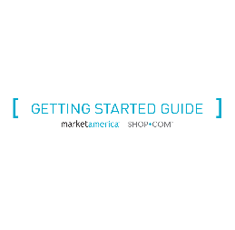
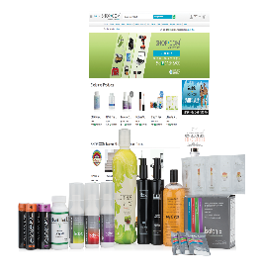
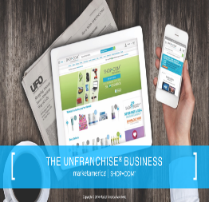
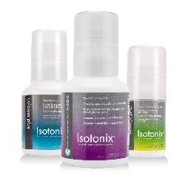
Global SHOP.COM
Shop Buddy Mobile
Direct Deposit Commissions
UnFranchise Mobile
Getting Started Guide
Auto
Form 1000
Free Shipping for Customers = $99 and over
Free Shipping for Customers = S$130 and over
Auto Form 1000
Advances in Simplicity, Automation, and Transparency to make the MPCP easier and more duplicable.
MeetON
Mobile
MPCP
Motives
Mobile
Online Vouchers
Shopping Annuity
Shopping Annuity
Online Vouchers
TLS MOBILE
Fast Start Kit
UBP
Product Kits
UF Media App

Slide 6
THE SAME BOILING WATER THAT SOFTENS THE POTATO HARDENS THE EGG
IT’S ABOUT WHAT YOU’RE MADE OF, NOT THE CIRCUMSTANCES.

Slide 7
Attitude and Knowledge

Slide 8
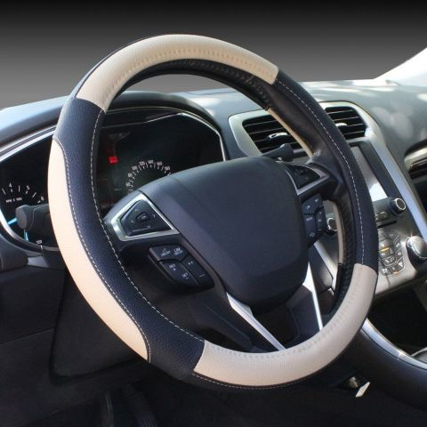
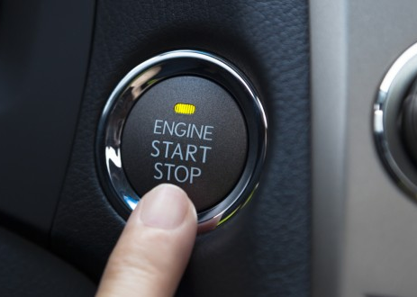
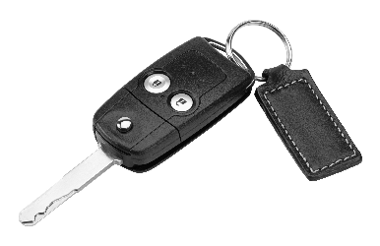
Attitude
Knowledge

Slide 10
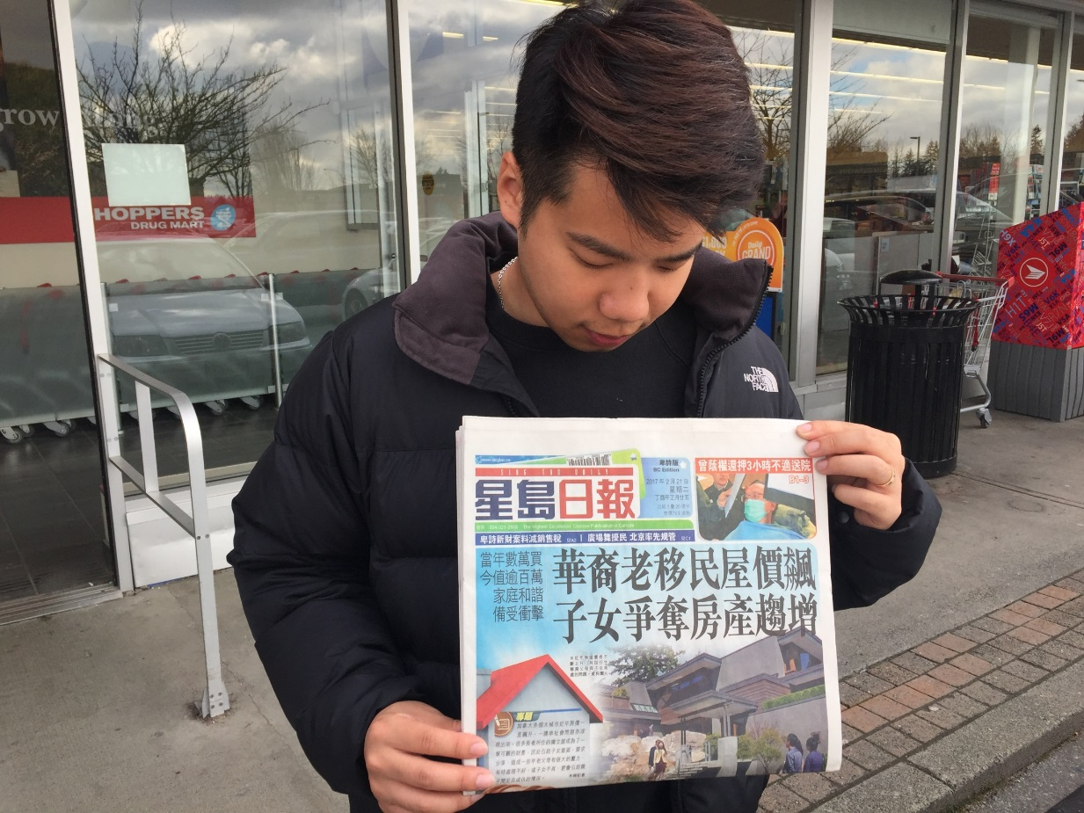
My biggest fear
CAME TRUE

Slide 12
It is your responsibility to sit down and think clearly what your WHY is ?
It is also your responsibility to share it with others, because you never know who you are going to INSPIRE
Notes:
It is your responsibility to sit down and think clearly what your WHY is ? It is ESSENTIAL to the success of the business (Father Story) It is also your responsibility to share it with others, because you never know who you are going to inspire

Slide 13
Attitude + Knowledge = BELIEF

Slide 14
Goal and a Goal Statement

Slide 15
GOAL and DREAM
DESTINATION
FUEL

Slide 16
It is about CONSISTENCY…
Keep Doing IT Build that
MOMENTUM

Slide 17
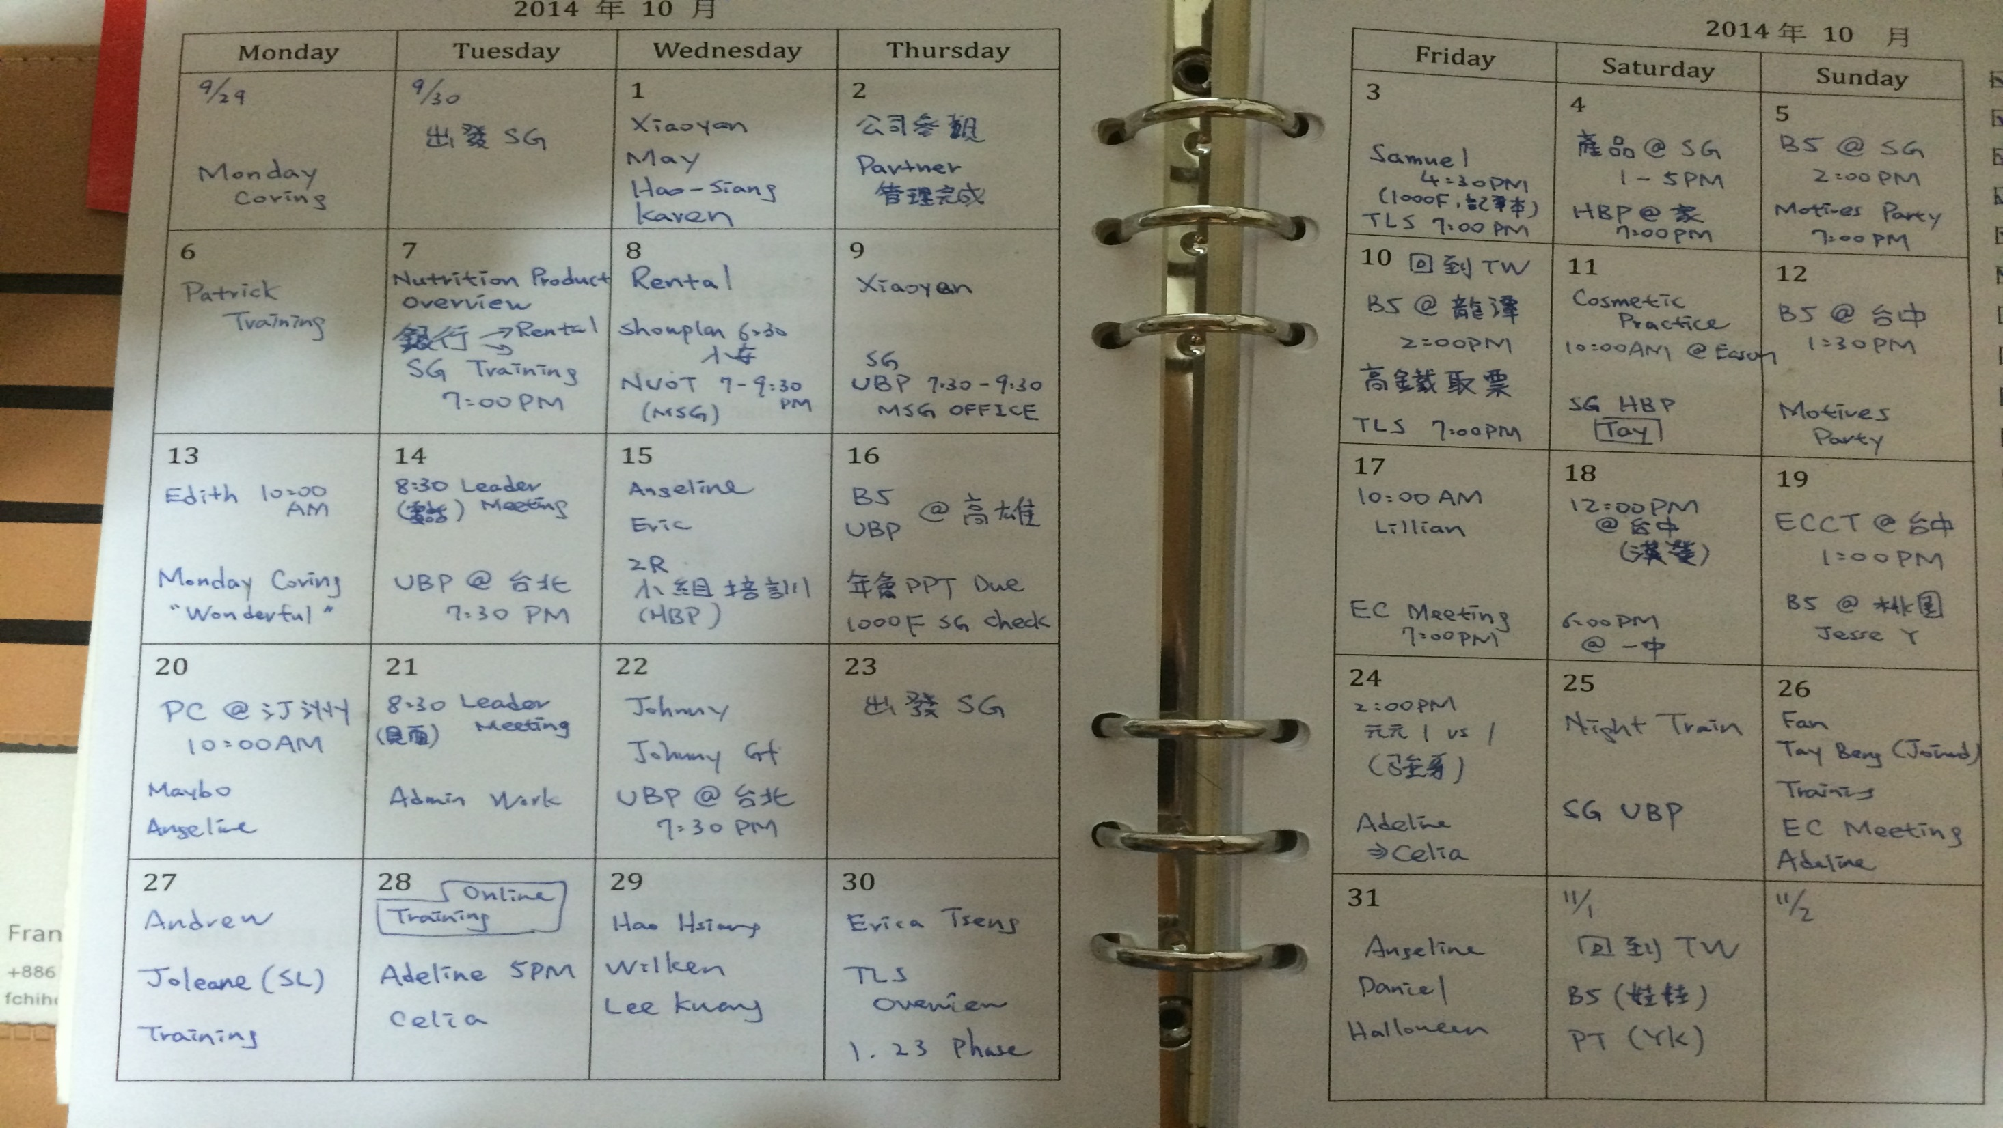

Slide 18
Retailing

Slide 20
How much BV would you expect a doctor to achieve monthly?

Slide 21
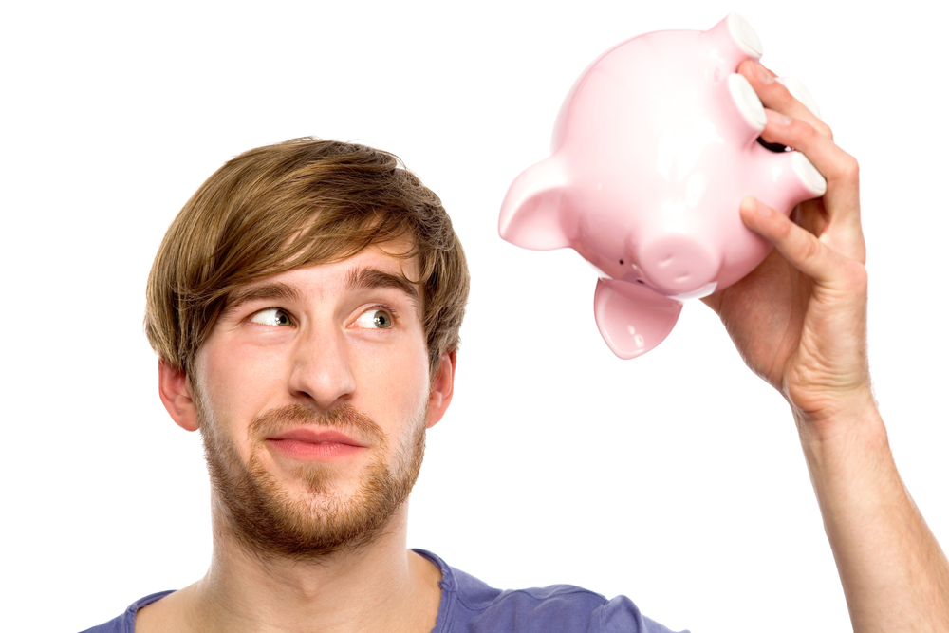
How much BV would you expect a struggling student to achieve monthly?

Slide 22
The goal is 500BV / Month

Slide 24
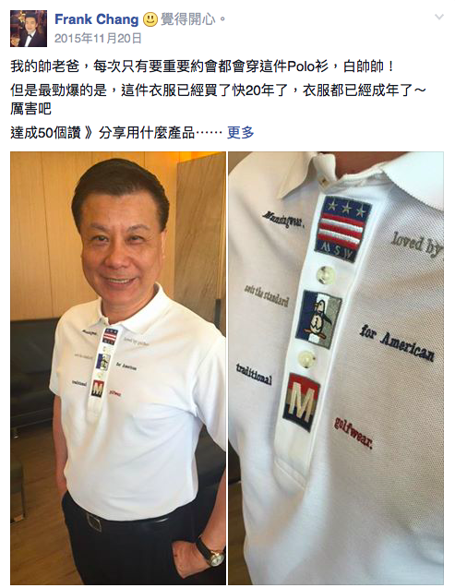
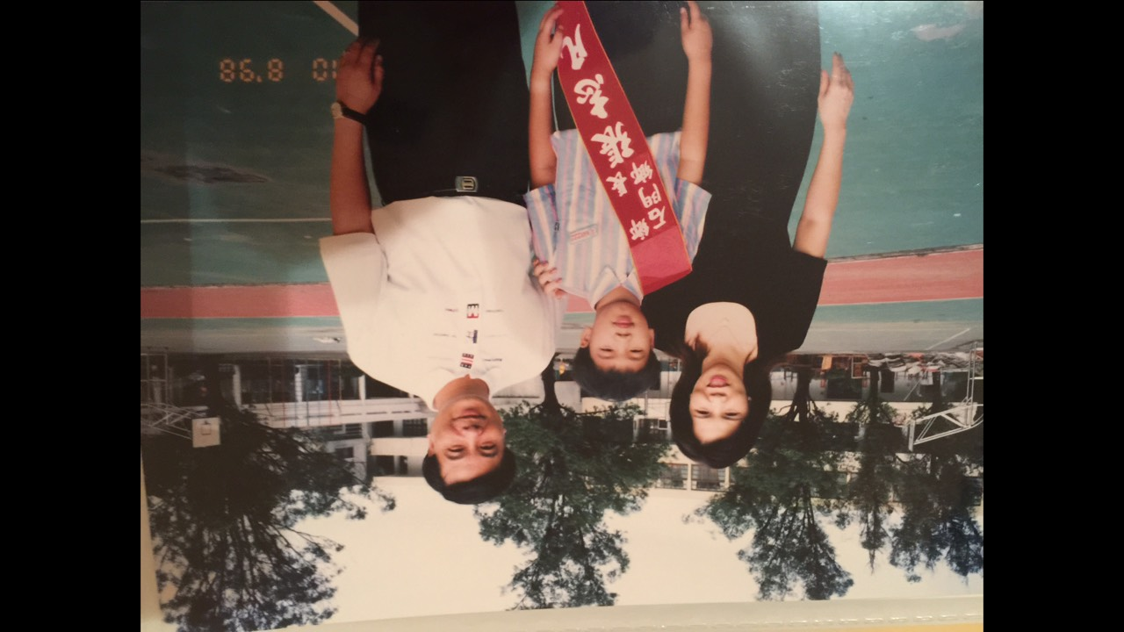

Slide 25
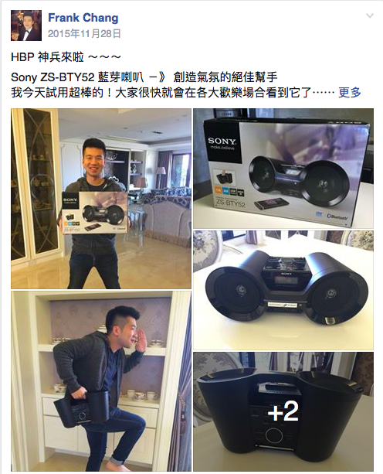
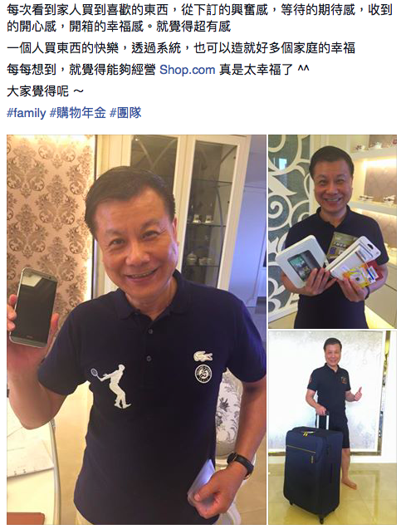

Slide 26
Prospecting Recruiting Sponsoring

Slide 27
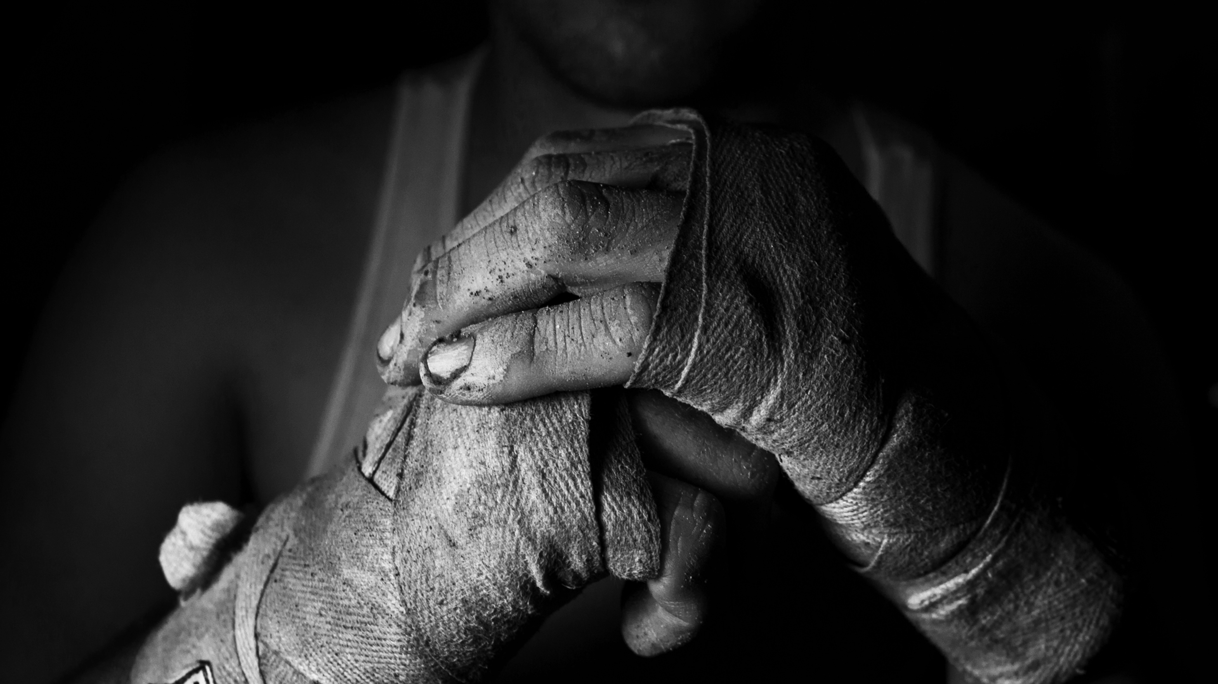
MY STRUGGLE

Slide 28
I learned how to “SHOWPLAN” I took CONTROL of my own business It was my first taste of FREEDOM

Slide 29
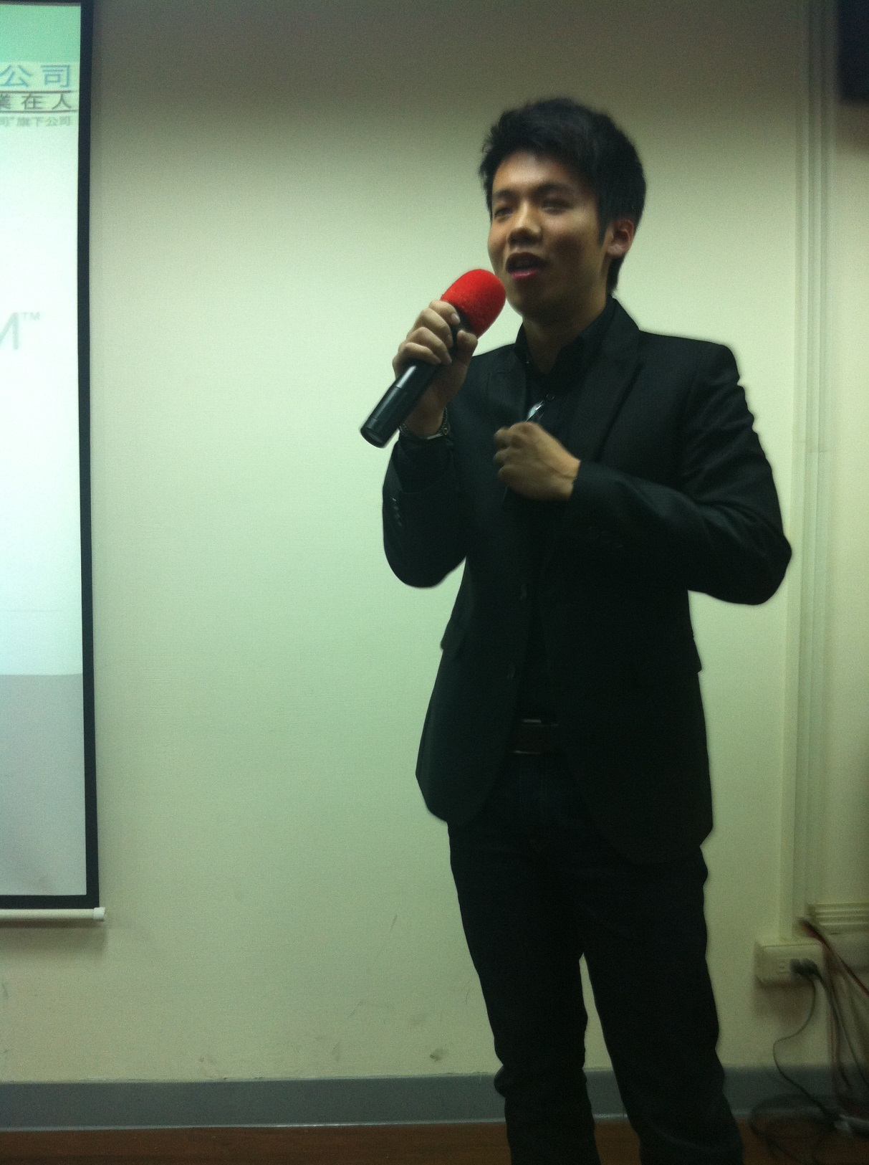
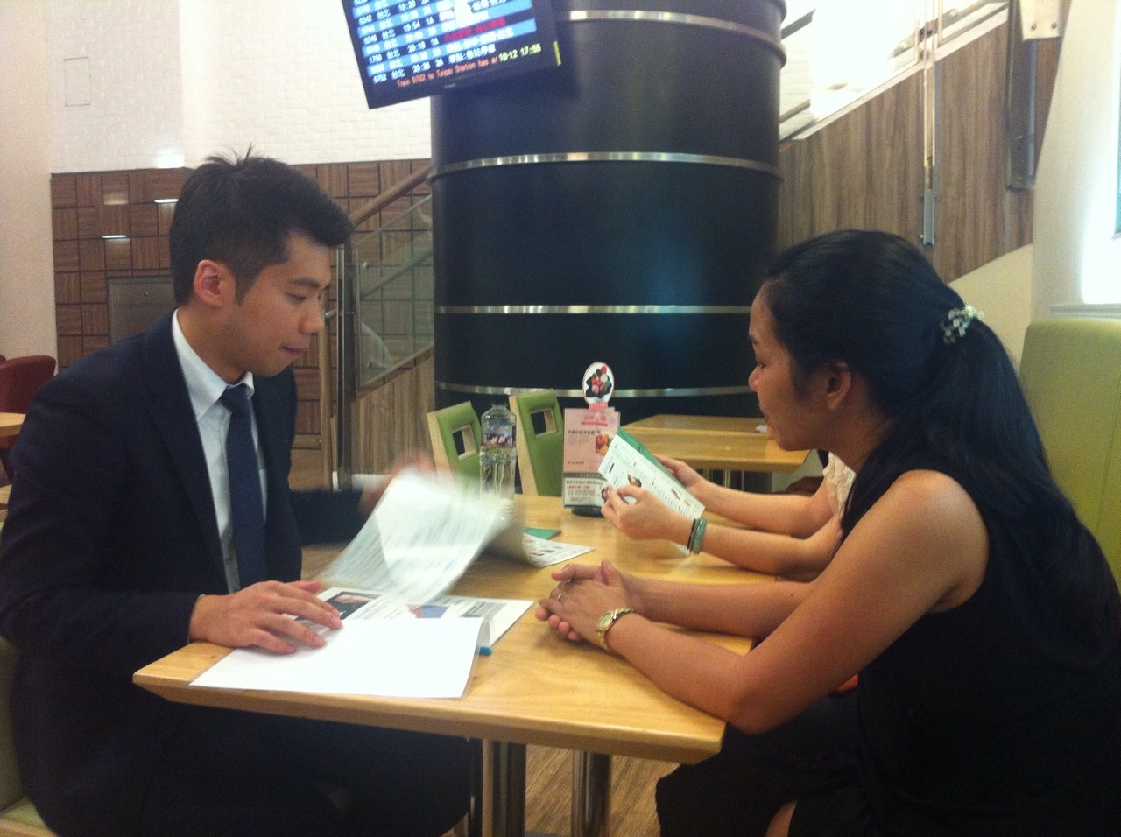
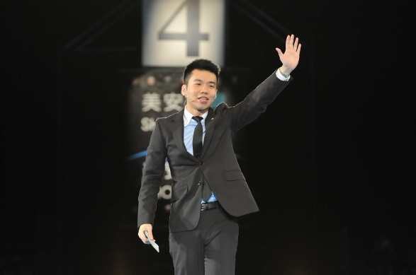
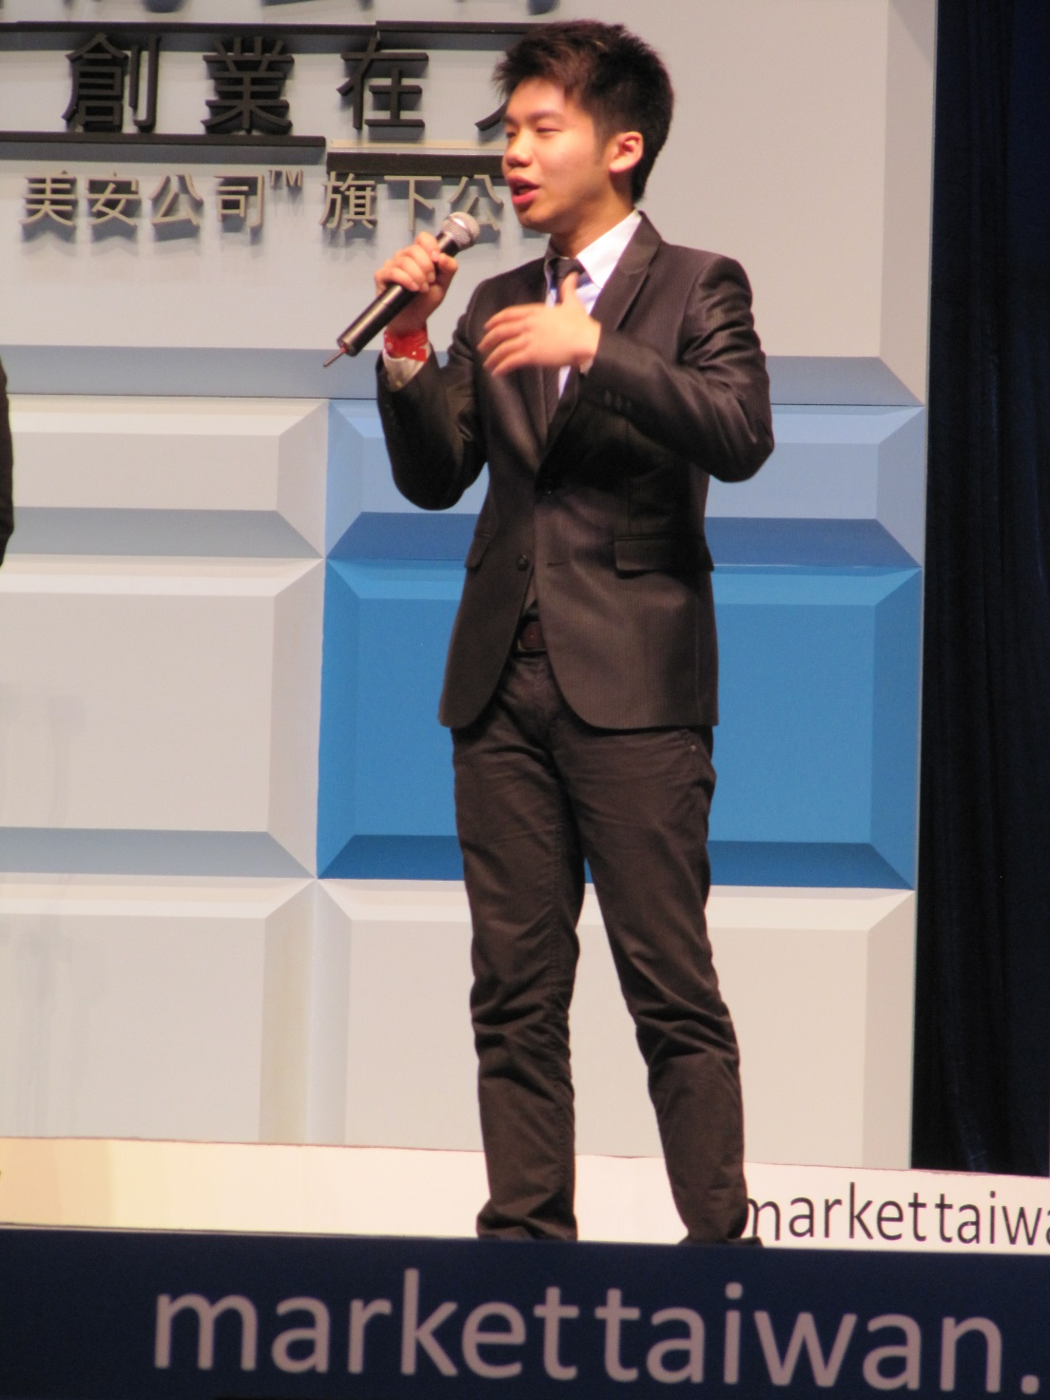
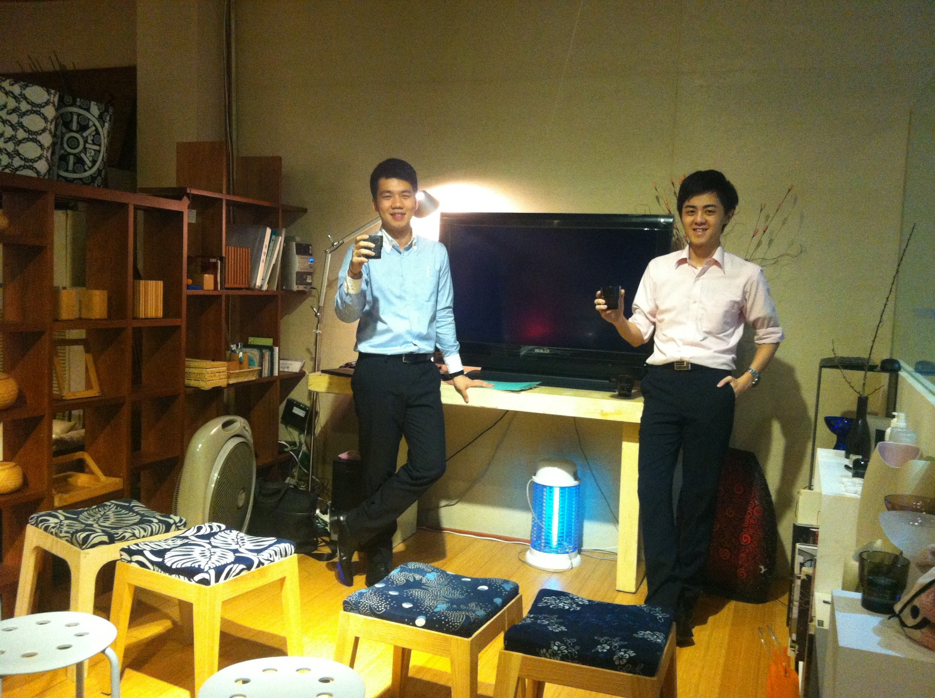

Slide 30
Those who TRUST you
Those who wants to CHANGE
Those who are GRATEFUL
Those who are willing to GIVE
Those who love to LEARN
Those who are DOWN TO EARTH

Slide 31
Follow-Up, Duplication and ABC Pattern

Slide 32
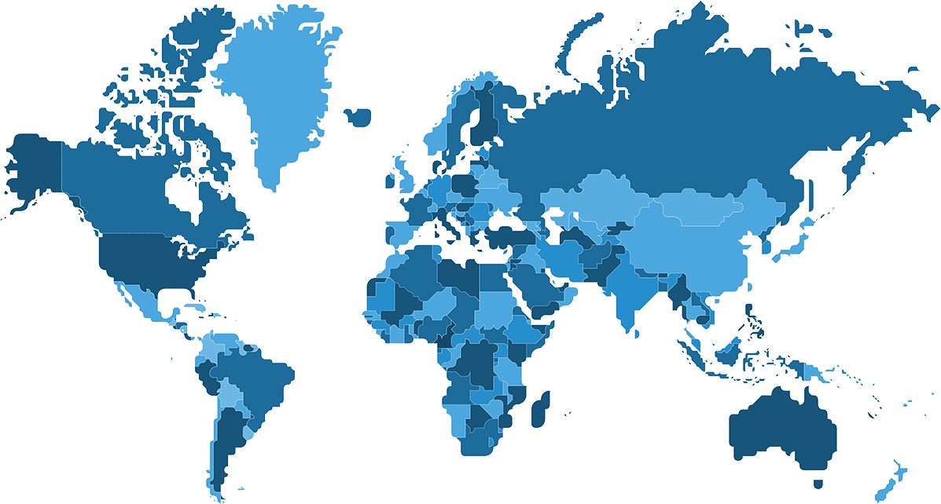

Slide 33
SPONSOR
YOU
Leverage team’s growth Gain Experience and Expertise
A
A
B
B
Become an independent UFO who is Reliable. Then become an UFO who is willing to HELP OTHER exceed themselves
C
C
A1
A1
B1
B1
C1
C1

Slide 35
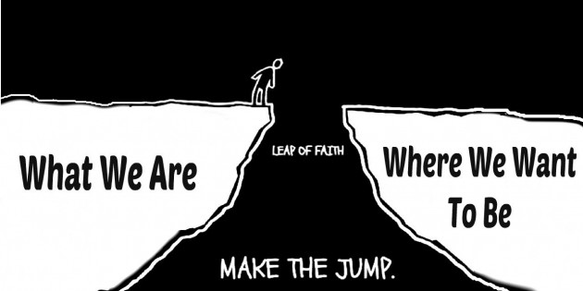

Slide 36
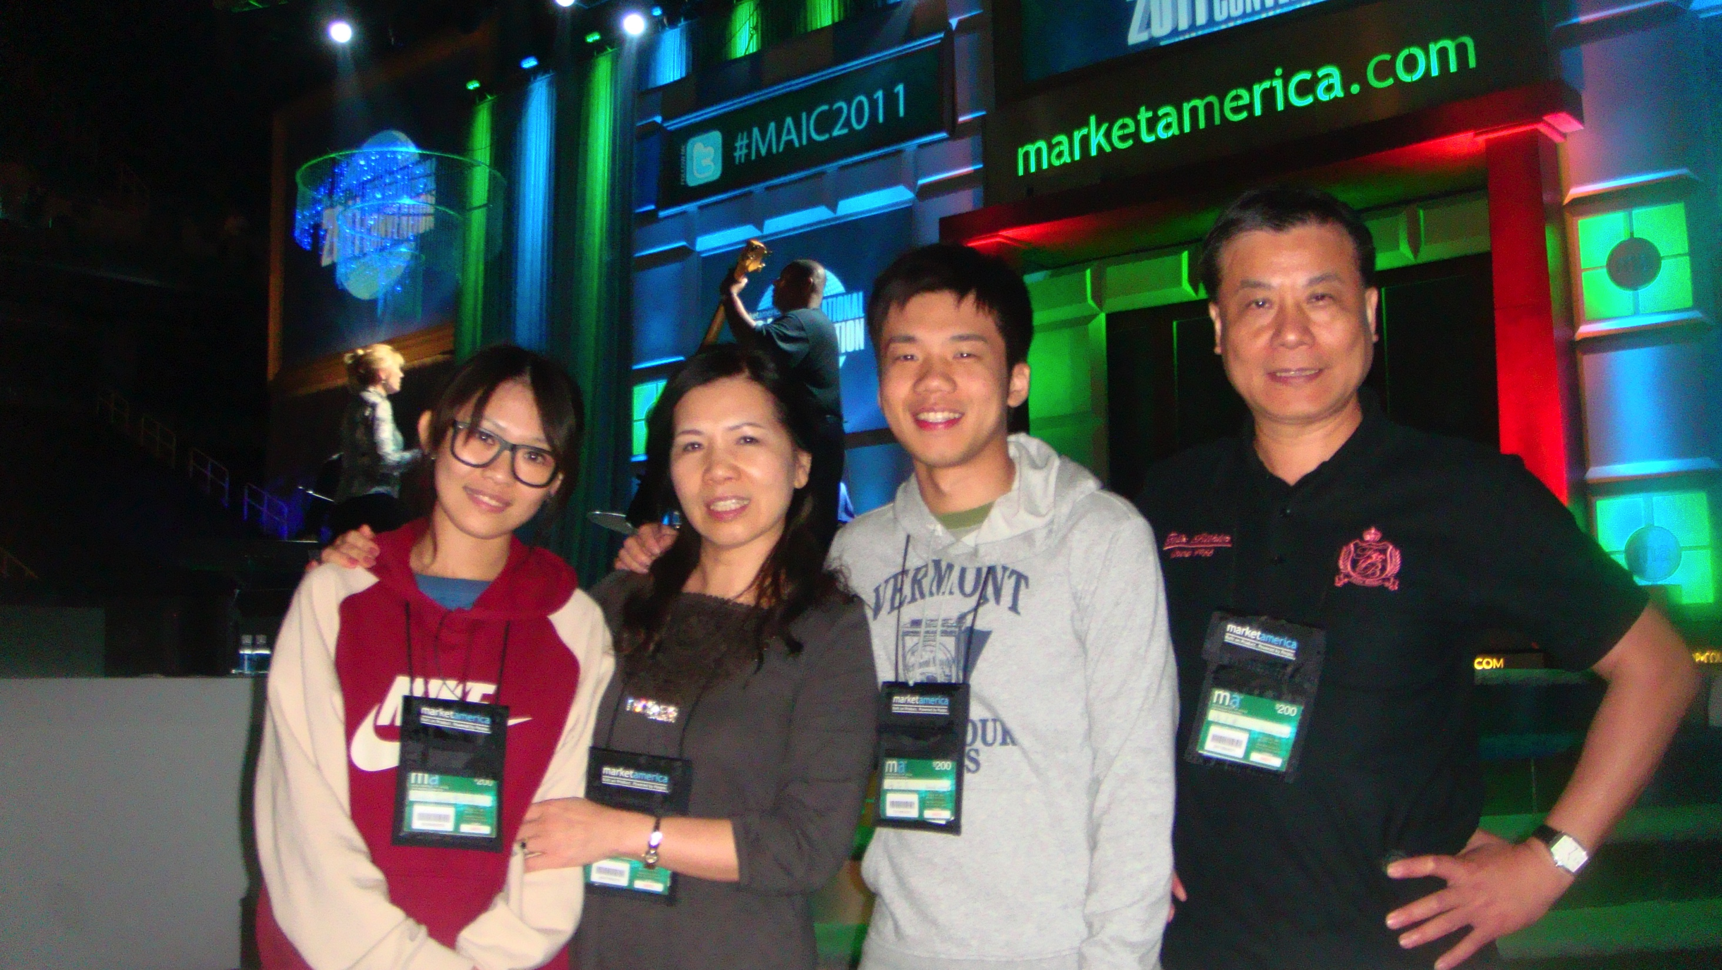

Slide 37
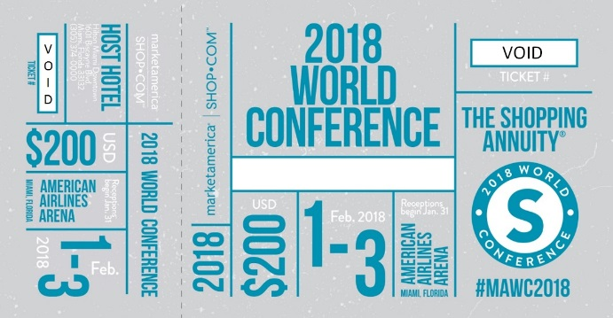

Slide 38
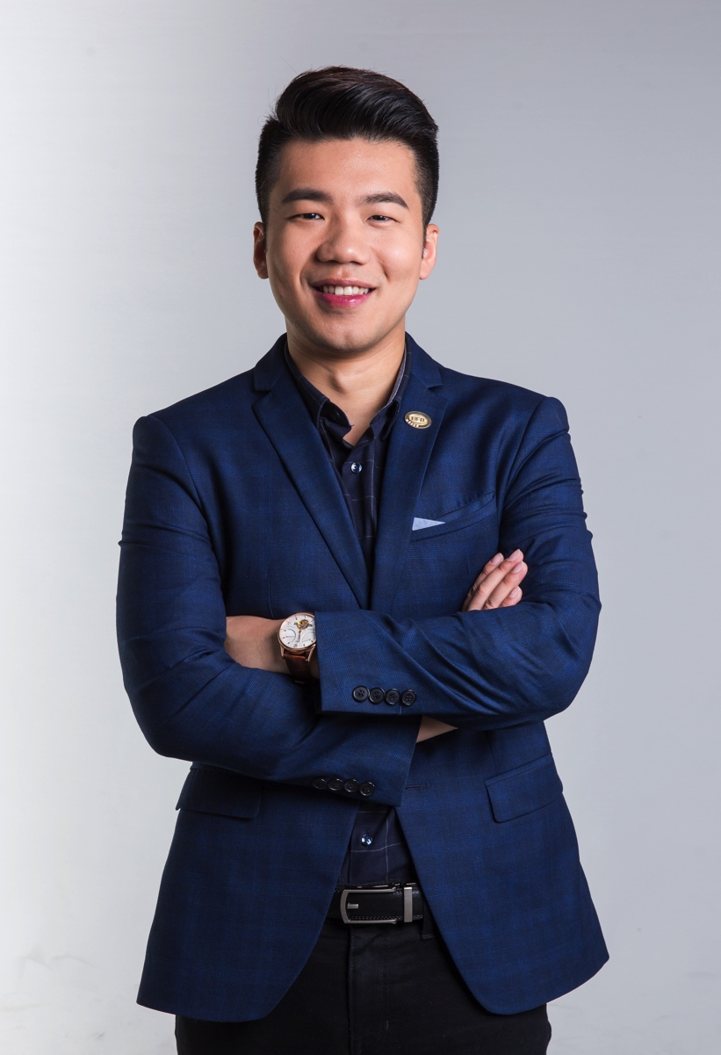
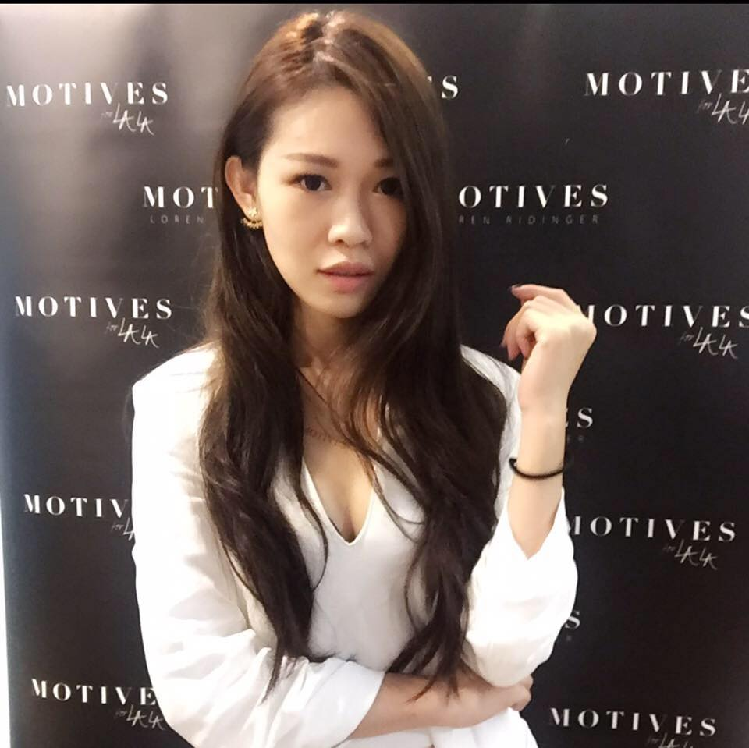

Slide 39
What did Basic 5 make me
Ｉt was never just about the MONEY,
UnFranchise Level, or who has the biggest team
When I look back, I can proudly say I MADE A DIFFERENCE and that DIFFERENCE started with me

Slide 40
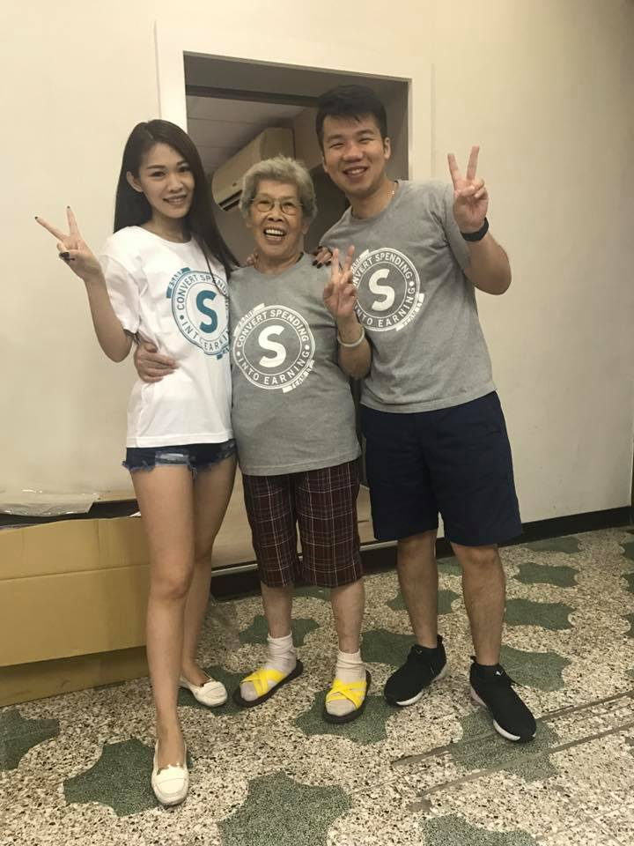
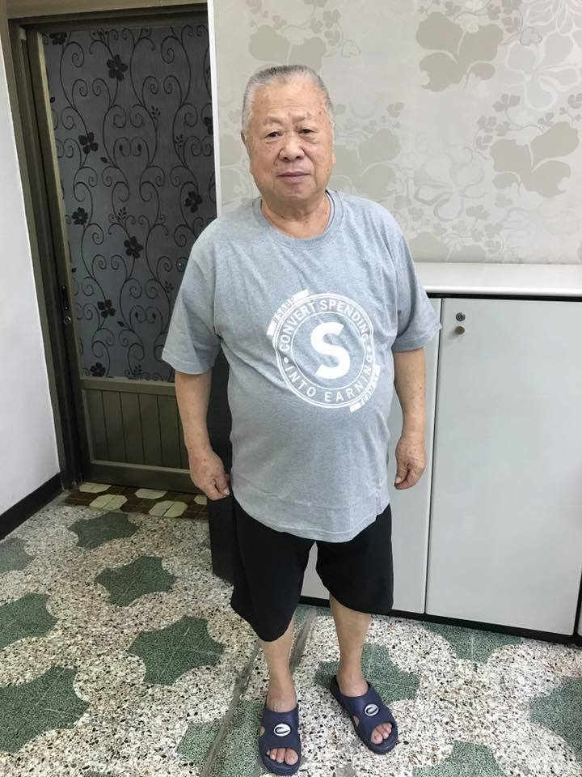
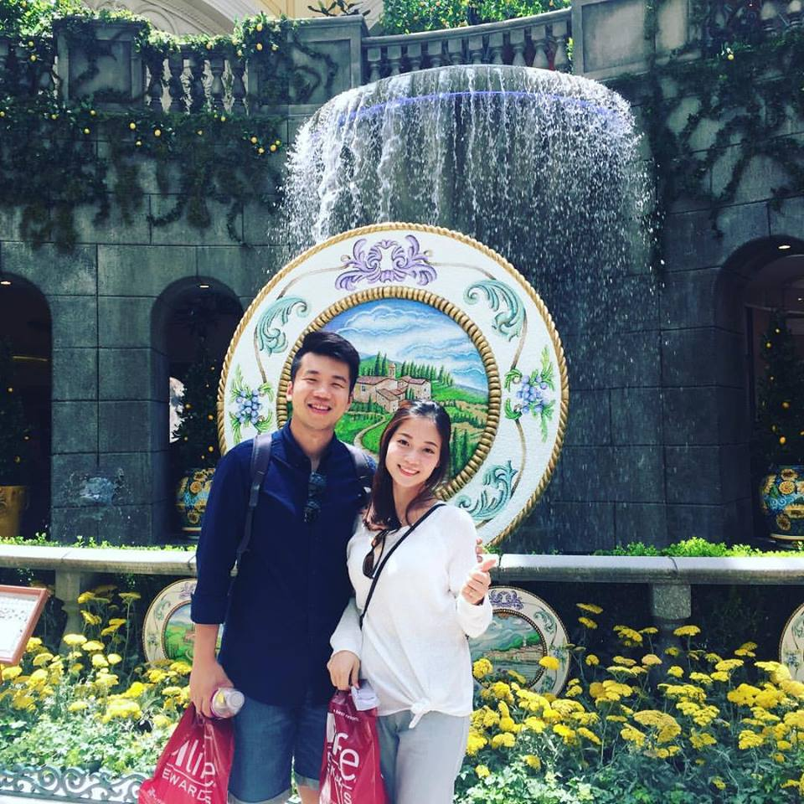
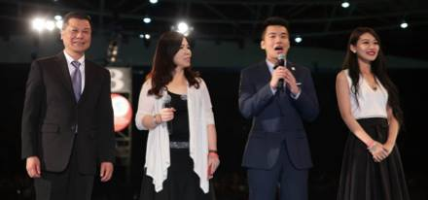

Slide 41
Master Your B5 [A Must for Business Success]
Frank Chang

Slide 42
THE BASIC 5 IS ANALOGOUS TO A 4 LEG STOOL WITH A SEAT WHEN BUILDING THE BUSINESS IN MANY WAYS
THE STOOL COULD BE A CHAIR WITH 4 LEGS
YOU sit or stand on top of the stool & build the business by following up and doing the ABC pattern, Showing plan, and following up correctly
Prospecting and Recruiting
100 possibility's, 2 per week.
8 personally sponsored per leg
Place strategically in ABC pattern
Attitude and Knowledge
Development: Tickets, GMTSS,
A tape or video per day. UF media App.
RETAIL + SHOPPING (SA) = 10 TO 20 PC’S , University Major Marketing, Shopping Annuity to become a customer product
A WHY and GOALS Translated into a Goal statement and action plan
Stability and Solid Foundation in order to duplicate
YOU MUST BE DOING AND DEVELOP ALL 5 OF THEM AT ONCE TO GROW AND DUPLICATE AND MAKE 6 FIGURES

